Slide 1



Docker Workshop – 3
By Zama

Slide 2
Agenda
Volume Types
Multi-stage builds
Hands-on

Slide 3
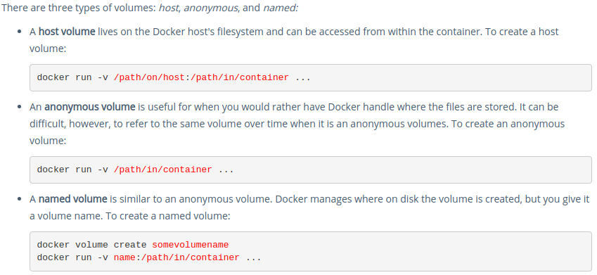
Docker: Volume

Slide 4
Docker: Copy files manually
Create folder and file:
mkdir data
nano cp.sh
echo '<EMP_ID> Running cp.sh file - '$(date)
CP:
Verify:
Copy file from host to container
//Copy file from host machine to container
docker cp data/ java8-app-c1:/data
//Login to the docker container
docker exec -it java8-app-c1
//Verify the file
ls -l data
cat data/cp.sh
//Run file
sh data/cp.sh
docker cp data/cp.sh /java8-app-c1:/data
Copy file from container to host
docker cp java8-app-c1:/data/cp.sh cp_2.sh

Slide 5
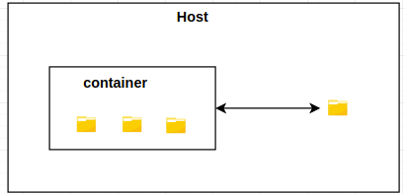
Docker: COPY vs ADD
COPY:
Copy files/folder from host machine to container without any conversions.
Add this line in Dockerfile:
COPY data/copy_1.tar.xz /
ADD:
Allows <src> to be a URL (If is a local tar archive in a recognized compression format (identity, gzip, bzip2 or xz) then it is unpacked as a directory).
Add this line in Dockerfile:
ADD data/add_1.tar.xz /

Slide 6
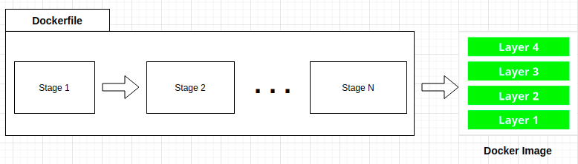
Multi-stage Builds

Slide 7
Resources
Instructions and source code for the hands-on is available at this location:
https://github.com/mbzama/docker-training

Slide 8
Thank You

